Slide 1
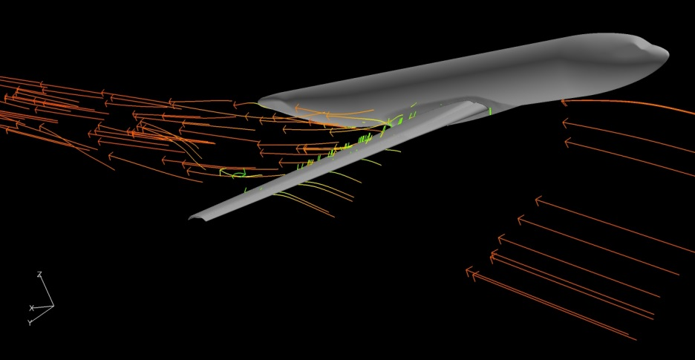
Understanding the Shortcomings of CFD in Predicting High Lift Configurations
Ciara Thompson
Embry- Riddle Aeronautical University

Slide 2
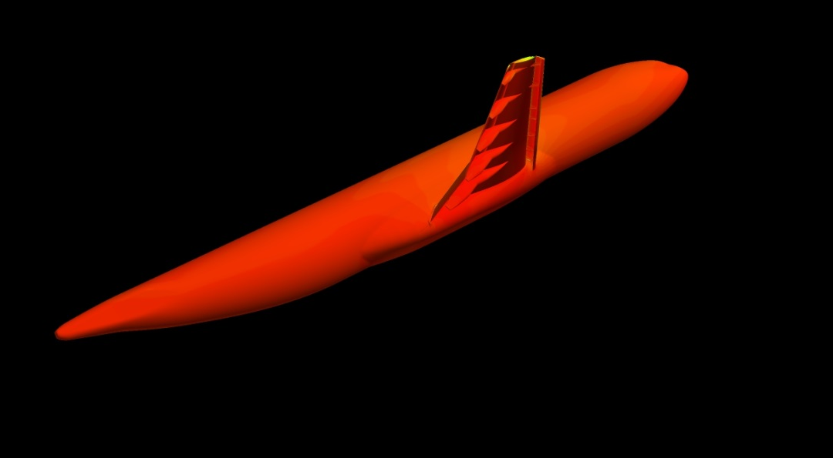
Purpose
Background
2nd AIAA High Lift Prediction Workshop
Assess the prediction capabilities of current CFD Technology
Validate CFD results by comparing to wind tunnel experiments
Compare CFD surface flow images to wind tunnel oil flow visualization images
Overview
Experiment
CFD
Experimental and CFD Data Comparison
Discussion
Further Work
Acknowledgments
Q &A

Slide 3
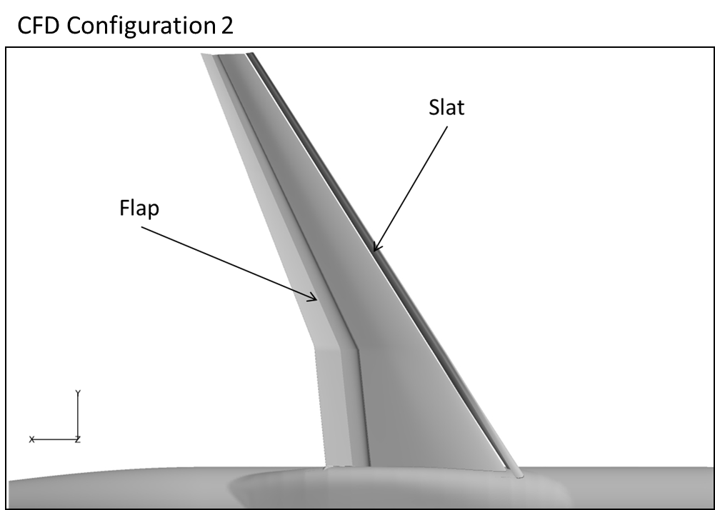
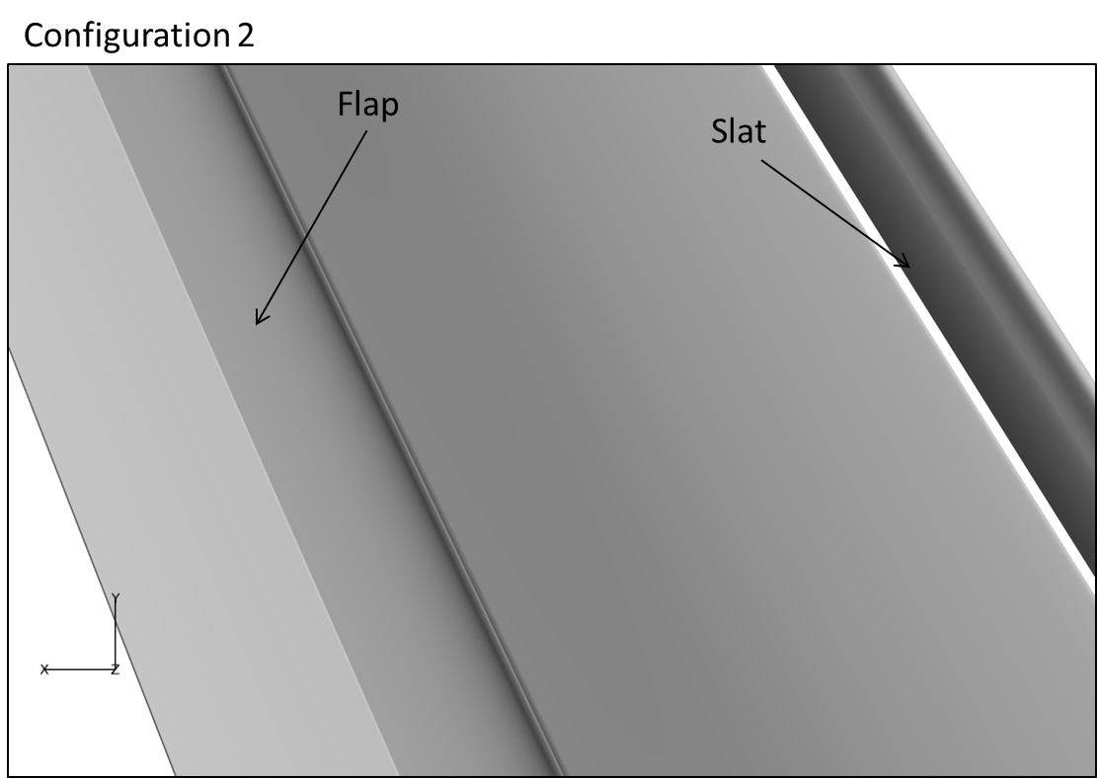
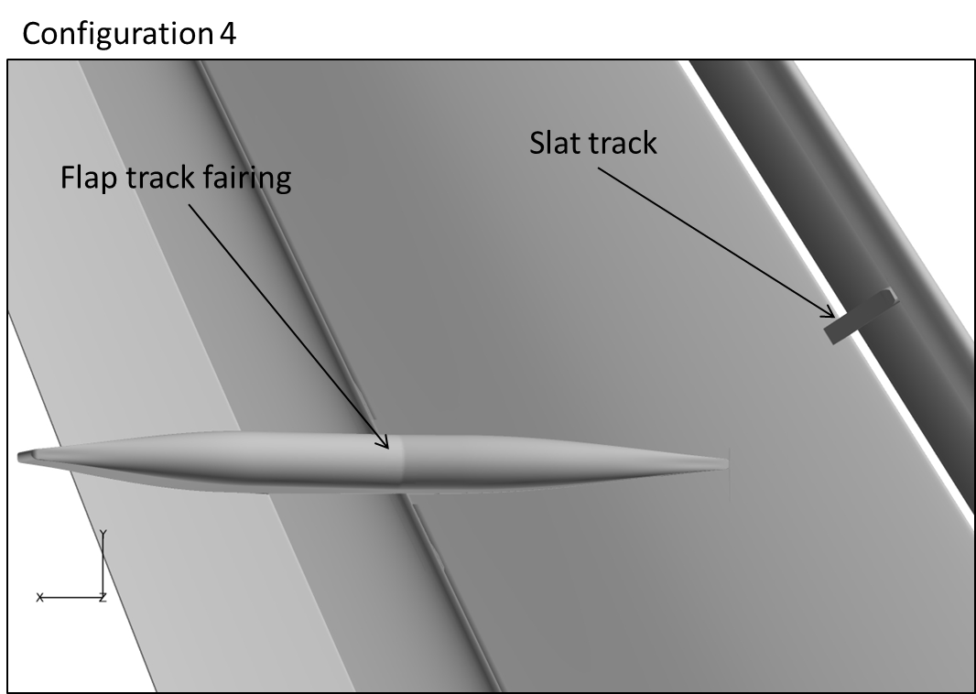
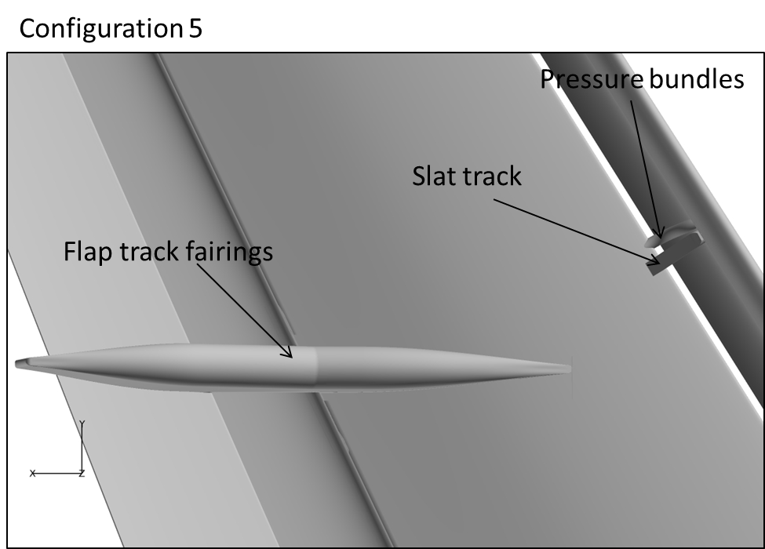
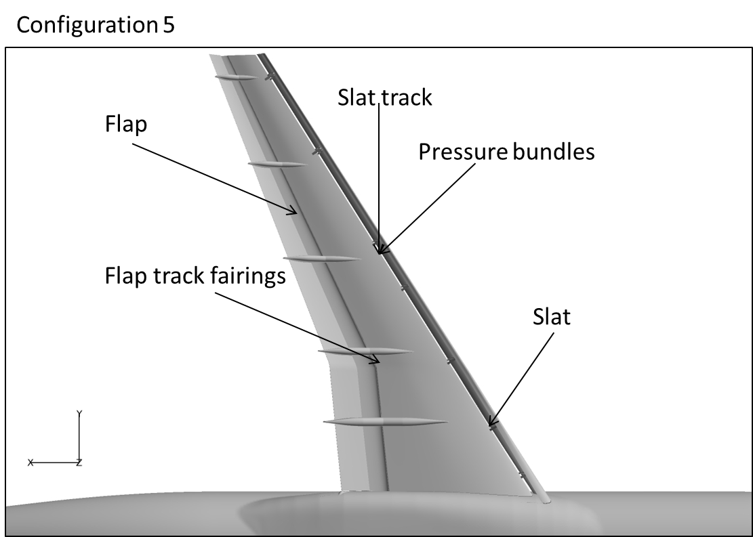
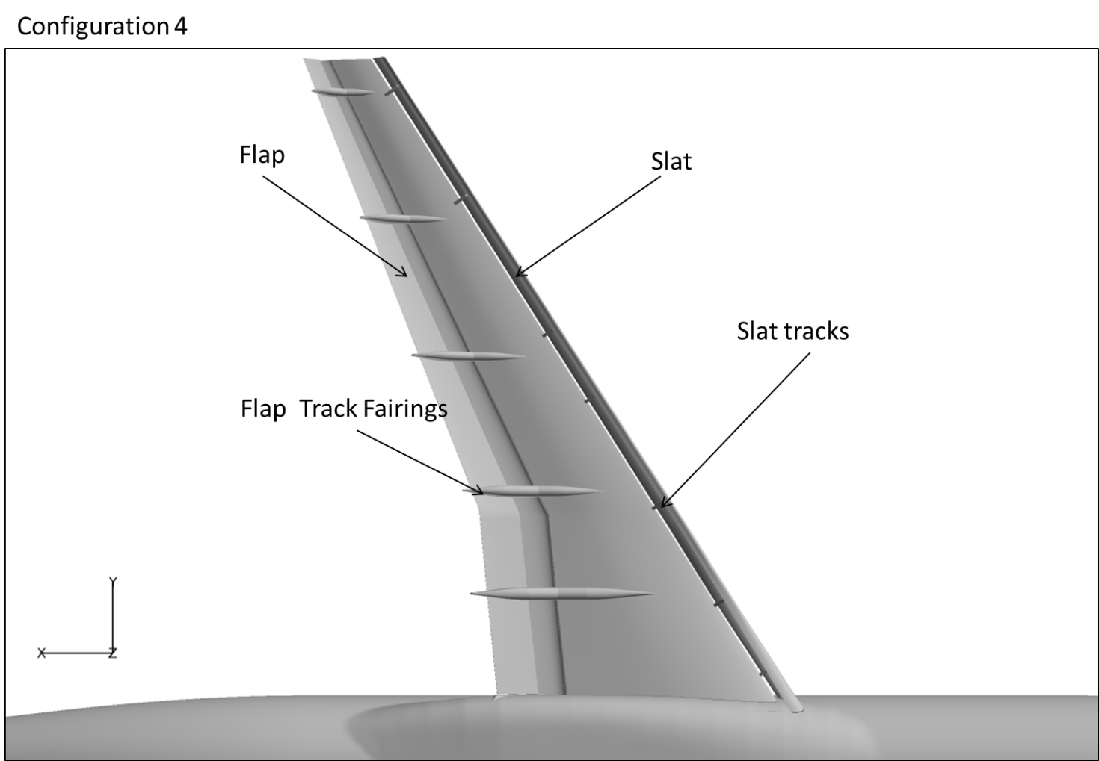
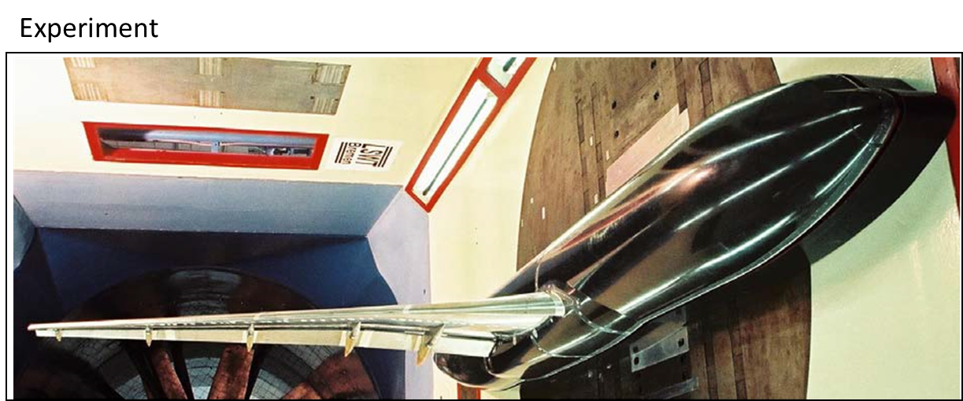
Model
KH3Y geometry
DLR-F11 model
EUROLIFT Project

Slide 4
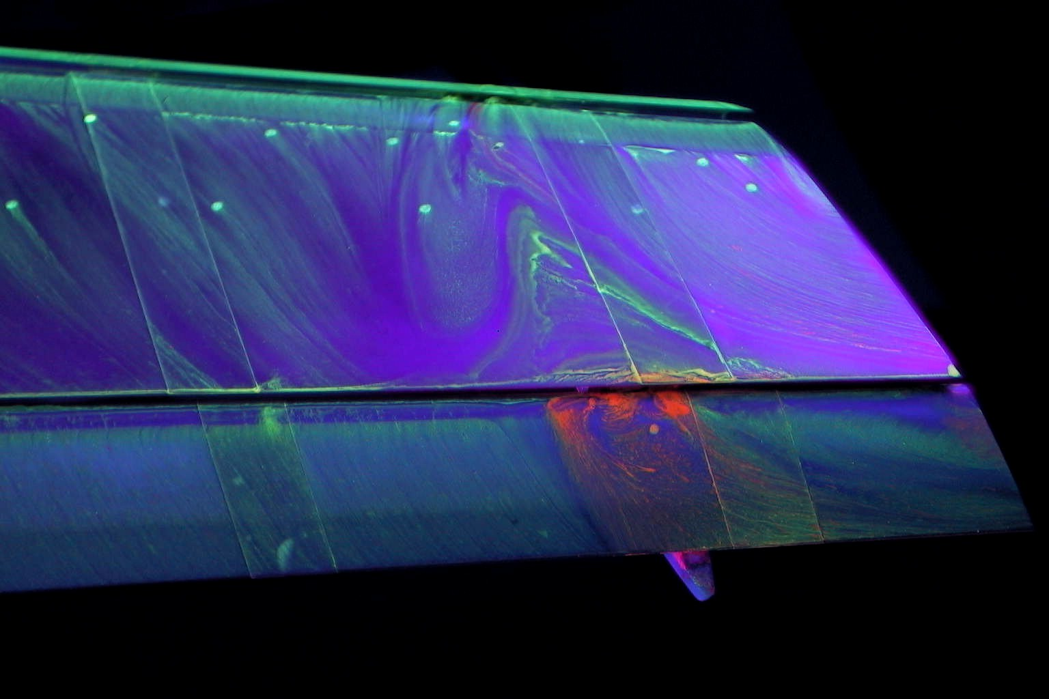
Experiment
Conditions
Low speed wind tunnel test with an operating range of 60m/s
Reynolds number 1.35e6
Mach number of 0.175
Data Analyzed
Oil flow visualization

Slide 5
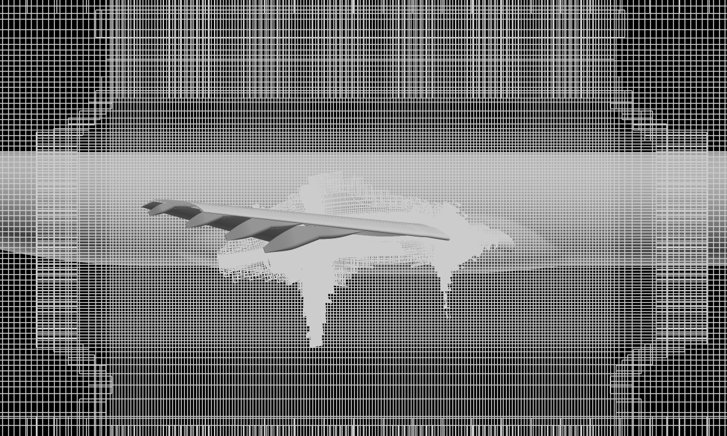
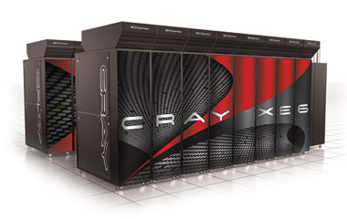
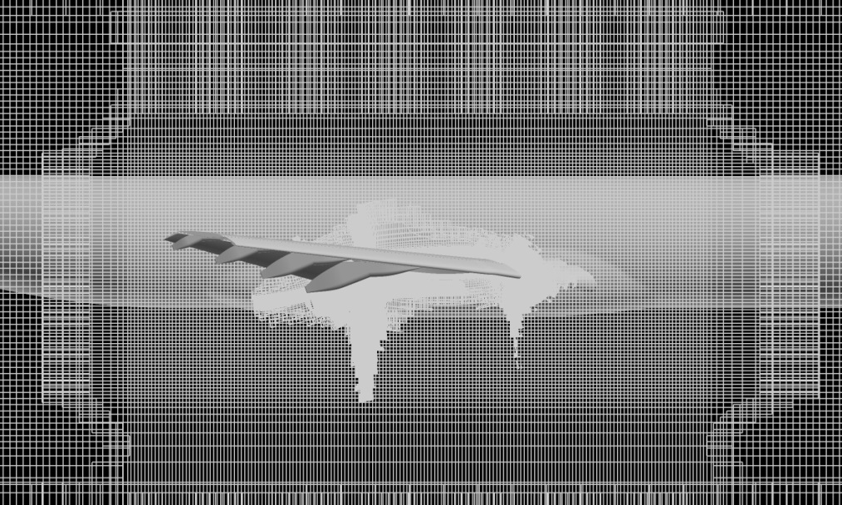
CFD
Cray XE6
1024 compute cores
24 hours of wall-clock time to converge
7GB per file
OVERFLOW 2.2e
Reynolds-Averaged Navier-Stokes solver by Pieter Buning, NASA Langley
Structured Cartesian grid-69 million grid points
Solver settings
Spalart-Allmaras
AOA-7,18.5 and 21 degrees
1 equation turbulence model
http://www.cray.com

Slide 6
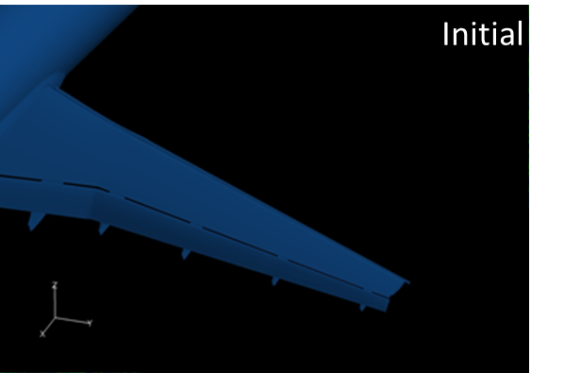
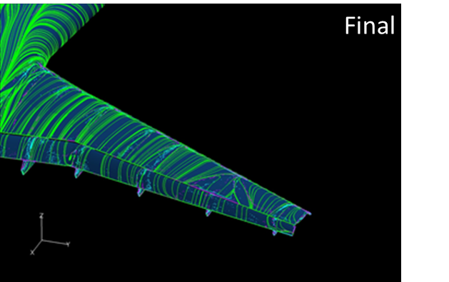
CFD Post Processing Procedure
Processed Data Provided by Dr. Earl P.N. Duque
Computing Power
6 core AMD Phenom ΙΙ Processor
16GB memory
FieldView 14
Created surface streamlines using surface flow tool
CFD Surface flow tool mimics oil flow visualization
Challenges
Slow

Slide 7
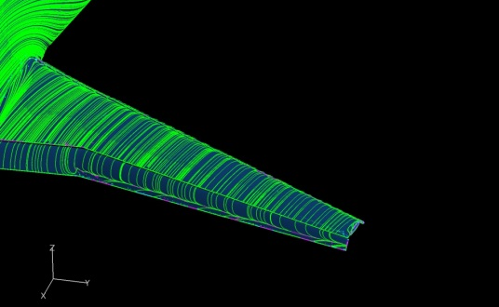
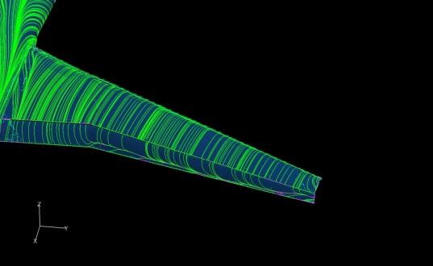
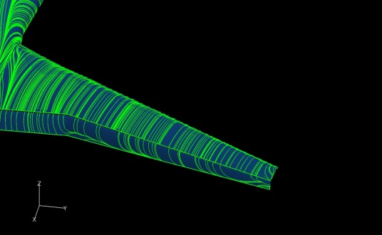
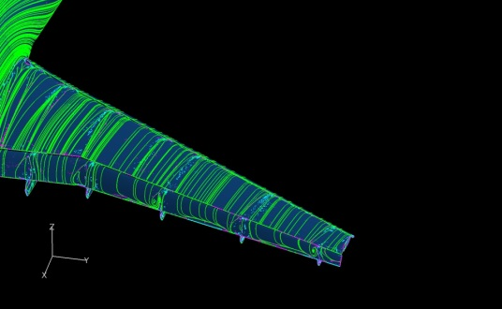
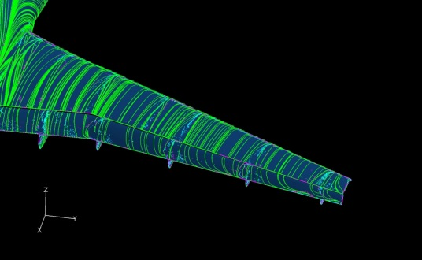
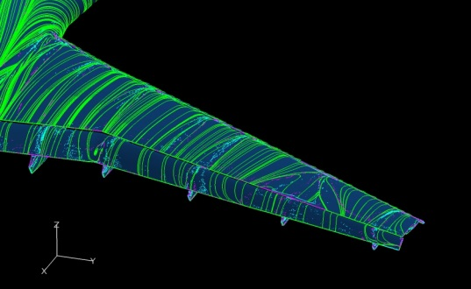
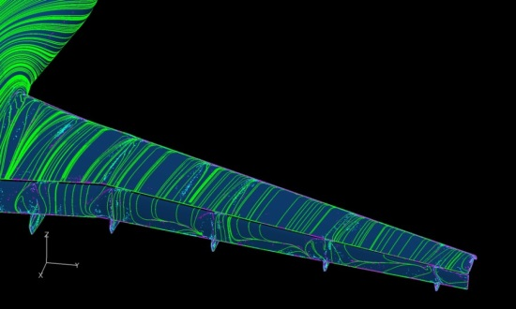
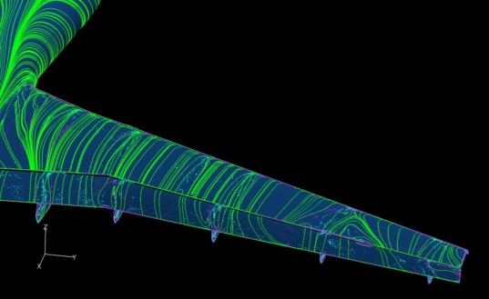
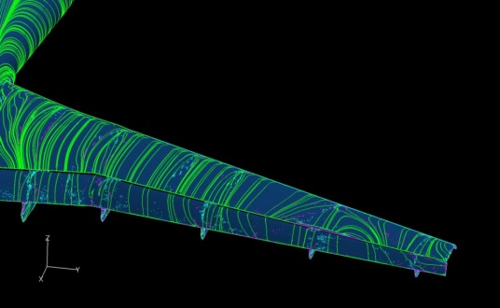
CFD Post Processing Results
Configuration 2
Configuration 4
Configuration 5
α=7̊
α=18.5̊
α=21̊
α=7̊
α=18.5̊
α=21̊
α=7̊
α=18.5̊
α=21̊

Slide 8

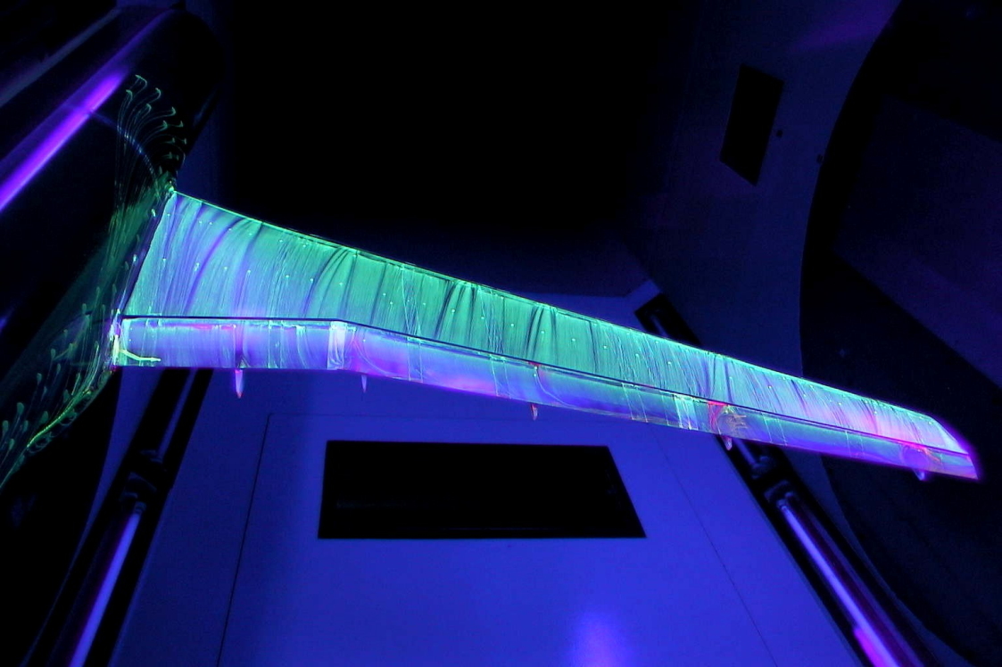
Experimental and CFD Data Comparison
8
Alpha: 7 degrees
α=7̊
Color Code
Pink – Separation
Green - Surface flow lines
Blue Lines- Reattachment
Reattachment lines
Experiment -Oil Flow Visualization
α=7̊
CFD-Streamlines

Slide 9

Experimental and CFD Data Comparison
9
CFD
Separation lines
α=7̊
Experiment
α=7̊

Slide 10

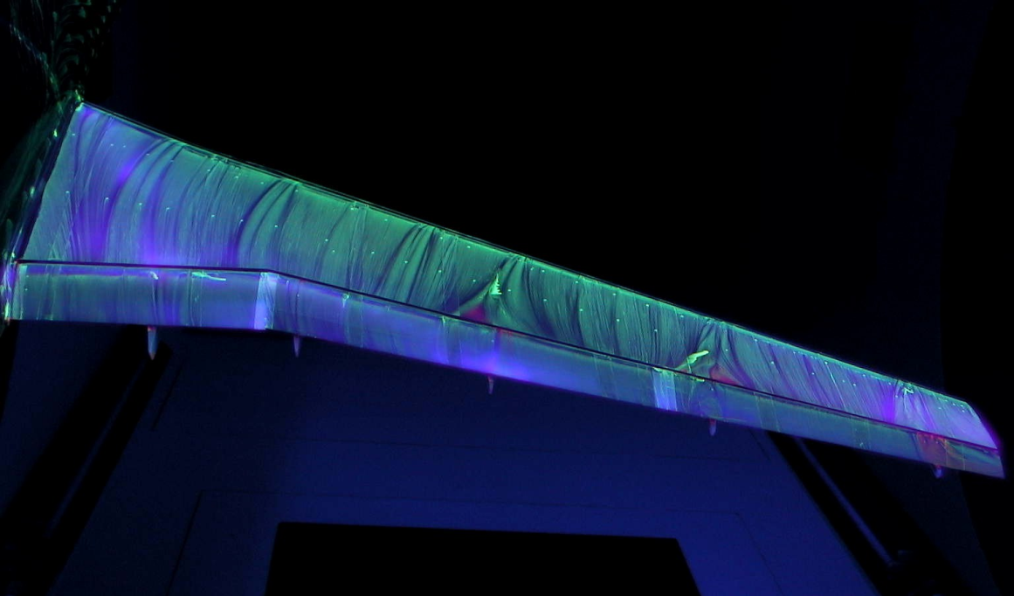
Experimental and CFD Data Comparison
10
Alpha: 18.5 degrees
α=18.5̊
Color Code
Pink – Separation
Green - Surface flow lines
Blue Lines- Reattachment
Reattachment lines
Separation Bubble
Experiment -Oil Flow Visualization
α=18.5̊
CFD-Streamlines

Slide 11

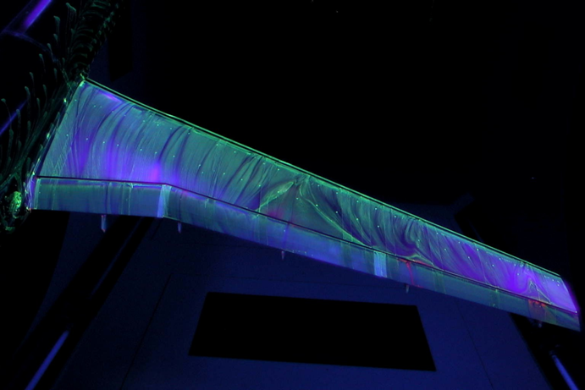
Experimental and CFD Data Comparison
11
Alpha: 21 degrees
α=21̊
Color Code
Pink – Separation
Green - Surface flow lines
Blue Lines- Reattachment
Reattachment lines
Separation Bubble
Experiment -Oil Flow Visualization
α=21̊
CFD-Streamlines

Slide 12
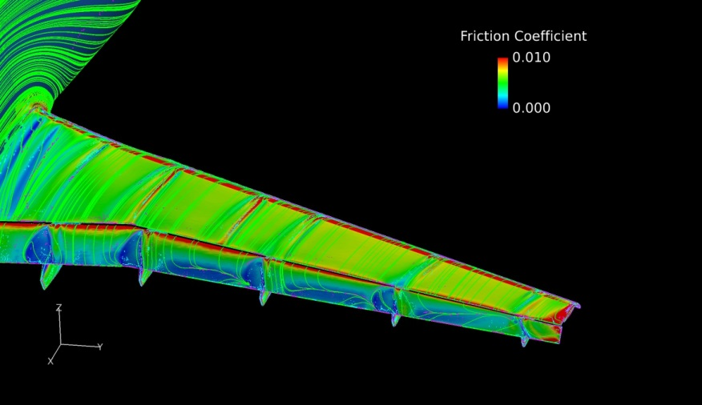
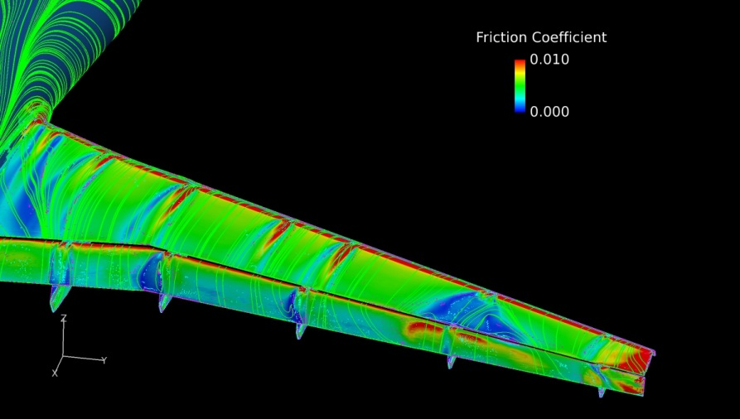
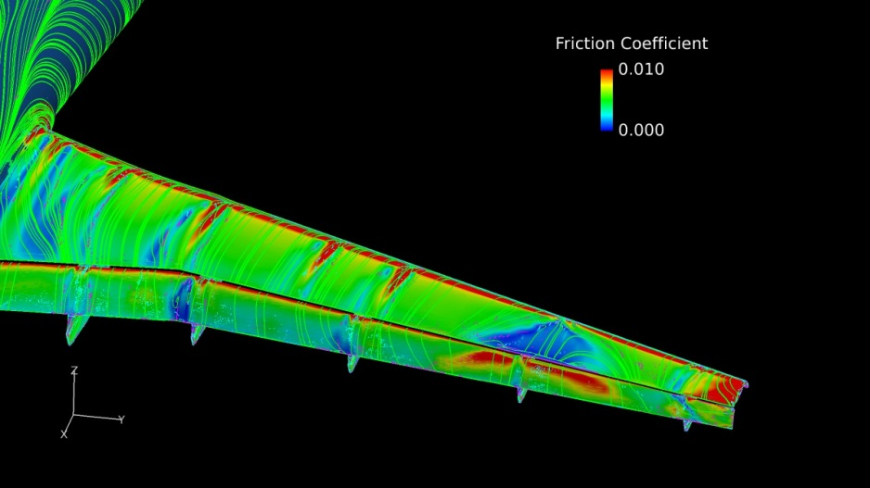
Shear Stress: Configuration 5
α=7̊
α=18.5̊
α=21̊

Slide 13

Experimental and CFD Data Comparison
Major Inconsistency
CFD
α=18.5̊
Experiment
α=18.5̊
α=21̊

Slide 14
Experimental and CFD Data Comparison
CFD
α=21̊
Experiment
α=21̊

Slide 15

Discussion
The results showed inconsistency in flow at higher angles of attack
Inconsistency may be a result of
CFD physical models
Wind tunnel errors

Slide 16
Future Work
Compare surface flow of configurations 2,4 and 5
Compare pressure distribution of configurations 2, 4 and 5
Determine the causes of inconsistency between experimental data and CFD data

Slide 17
Acknowledgments
CFD images were created using FieldView as provided by Intelligent Light through its University Partners Program
Simulations were performed by Dr. Earl P.N. Duque, Manager of Applied Research, Intelligent Light
NASA Space Grant
Faculty Advisor Dr. Shigeo Hayashibara

Slide 18
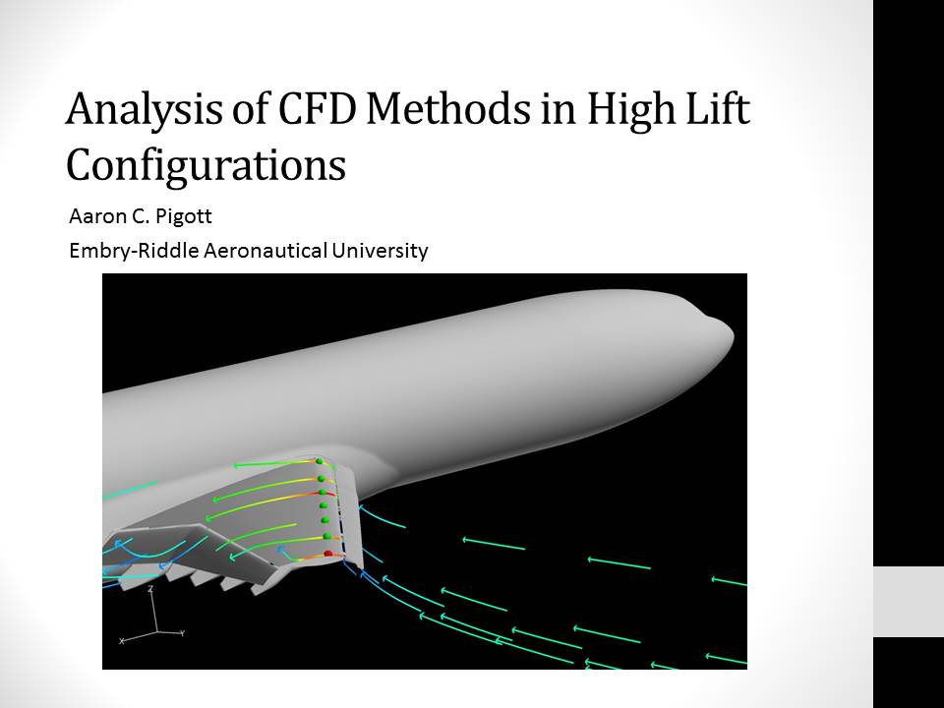

Slide 19
Q&A

Slide 20
Appendix

Slide 21
References
Rudnik, R., Huber, K., Melber-Wilkending, S. “EUROLIFT Test Case Description for the 2nd High Lift Prediction Workshop”, AIAA 2012-2924, 2012
Nichols,R., Bunning,P., “User’s Manual for Overflow 2.2”, August 2010
Intelligent Light, FieldVIew 14, Software Package, Ver. 14, Rutherford, NJ
Christopher, R., “2nd AIAA CFD High Lift Prediction Workshop (HiLiftPW-2)”, NASA [http://hiliftpw.larc.nasa.gov/]
All experimental results shown here were obtained from AIAA 2012-2924

Slide 22
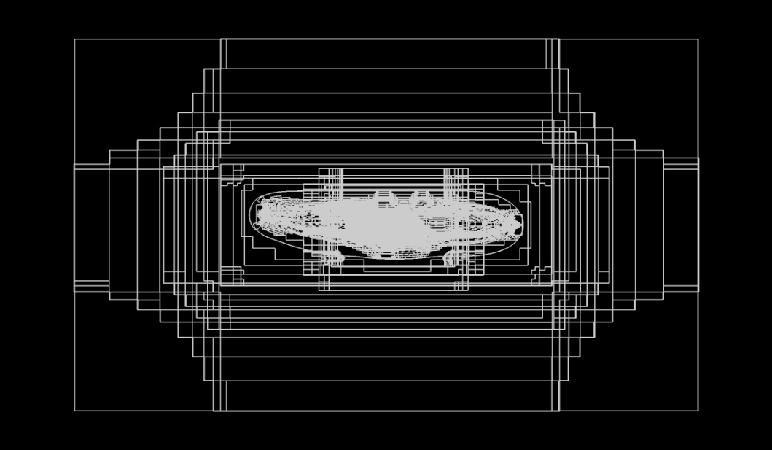
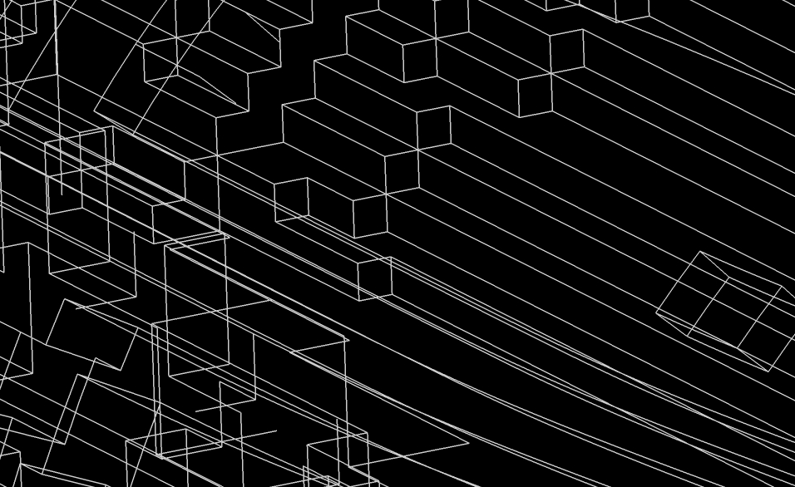
CFD- Code
OVERFLOW 2.2e
This code is a finite difference mesh and solver
It is a three dimensional time marching implicit Navier-Stokes code which can also be used for two-dimensional or axisymmetric mode
The mesh is a structured grid system which consists of an overset of Cartesian grids to develop the desired model
The model was meshed with a medium grid

Slide 23
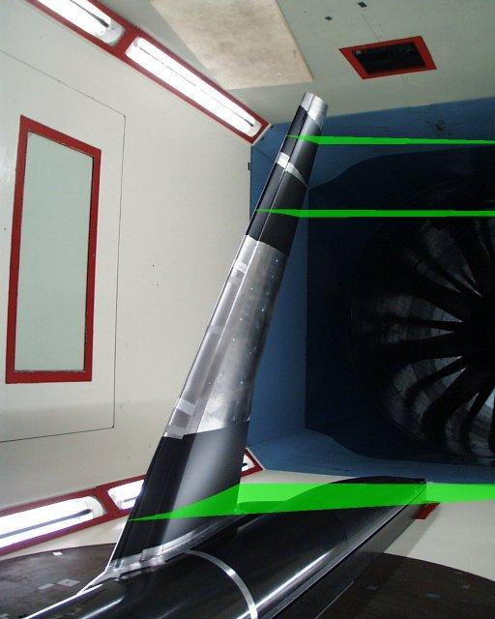
AIAA High Lift Prediction Workshop (Background)
The aim of the High –Lift PW was to assess the prediction capabilities of current CFD technology and to enhance CFD prediction capability for high lift configurations
The 2nd workshop was based on an experiment conducted under the German Aerospace Center for the European project EUROLIFT
The experiment was based on a typical geometry of a commercial high lift aircraft developed for the project and defined as the KH3Y geometry. The model was developed by the German Aerospace Center and denominated as the DLR-F11
The experiment was conducted in the low speed wind tunnel of Airbus in Bremen, Germany and in the high speed European
Transonic Wind tunnel
AIAA 2012-2924

Slide 24
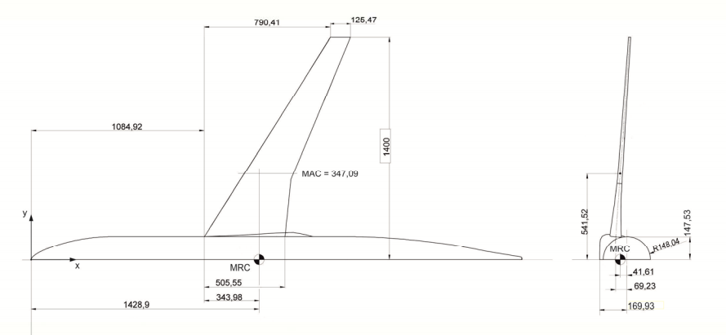
Experiment
Model
The experimental model consists of a fuselage, and wing consisting of the following components: leading edge slat, and trailing edge Fowler flap
Two configurations were developed
Landing Configuration
Take off Configuration
The dimensions of the model are as follows
Half Span, s [m] | 1.4
Wing reference area, A/2 [m²] | 0.41913
Reference chord | 0.34709
Aspect Ratio | 9.353
Taper Ratio | 0.3
¼ chord sweep | 30
Fuselage length | 3.077
http://hiliftpw.larc.nasa.gov/

Slide 25

CFD: Solver Settings
Turbulence model
Spalart-Allmaras
1 equation turbulence model derived using empirical relationships, dimensional analysis and Galilean invariance
Fast and numerically stable turbulence model suitable of shear layers and boundary layers
Mathematical description the turbulence model
The mathematical model describes the production and dissipation of the turbulence

